Slide 1
Age: Language Change
Charalambos Themistocleous
www.charalambosthemistocleous.com
themistocleous@gmail.com

Slide 2
Variation and language change.

Slide 3
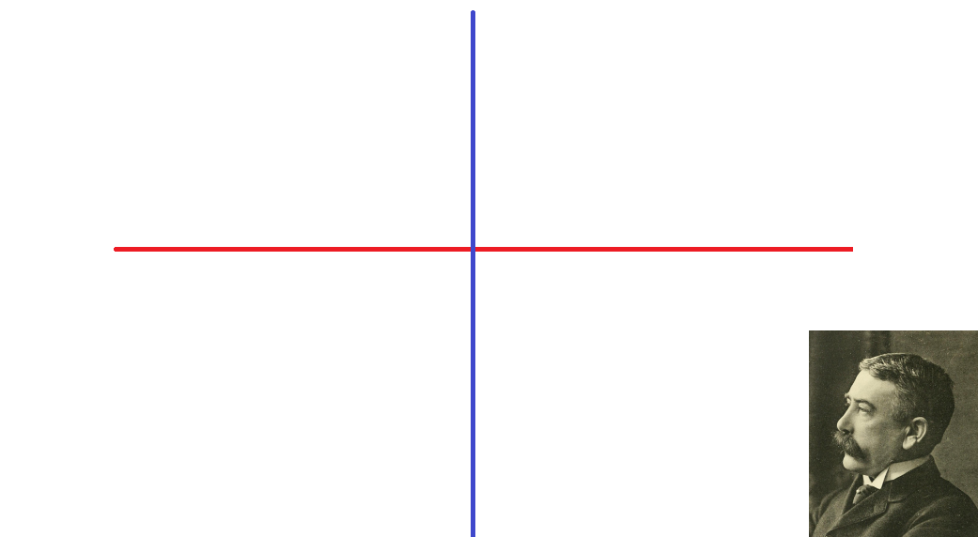
Language Change
Diachrony
Synchrony
Ferdinand de Saussure

Slide 4

Doctor Who

Slide 5
1. The cumulative principle. The more that we know about language, the more we can find out about it, and we should not be surprised if our search for new knowledge takes us into new areas of study and into areas in which scholars from other disciplines are already working.

Slide 6
Factors such as age, social class, gender play a role in language change.

Slide 7
2. The uniformation principle. The linguistic processes which we observe to be taking place around us are the same as those which have operated in the past, so that there can be no clean break between synchronic (i.e., descriptive and contemporary) matters and diachronic (i.e., historical) ones.

Slide 8
Real time studies: study the way people talk at one point in time with the way they talk as time passes; the passing of years, hours, minutes.
Apparent time studies: study the language change by abstracting from the way speakers of different ages talk at a single point in time.

Slide 9
Apparent time studies
The apparent passage of time is measured by comparing speakers of different ages in a single-speech community at a single time. If younger speakers behave differently from older speakers, it is assumed that change has taken place within the community.
The apparent time construct relies on the assumption that speakers only minimally change the way they speak after a critical period of adulthood.
A useful method where real time data is absent.

Slide 10
How language was in the past.
How language will change in the future.

Slide 11
Our earliest sound recordings only go back in the middle of the nineteenth century.
There is an analysis of Greek Rembetika (begining of the 20th century) by Arvaniti and Joseph who study /b d ɡ/ word initially and word-medially.
Written speech.

Slide 12
Real time studies
Rickford and McNair-Knox’s (1994) compared interviews done with Foxy while she was at high school with ones done after she had moved on to the university.

Slide 13
Types of real time studies
Panel studies: Studies of variation across real time when participants are the same.
People leave the study, move to another place, die etc.

Slide 14
Trend studies: these studies involve comparing speech from members of the same community at different points in time.

Slide 15
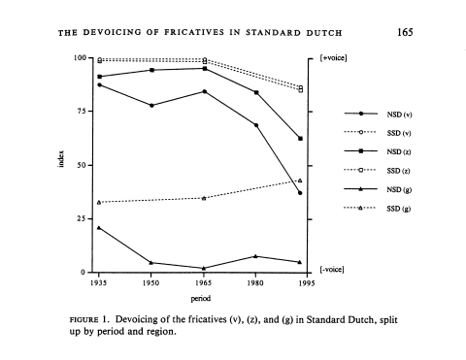
Title: The devoicing of fricatives in Standard Dutch: A real-time study based on radio recordings Author(s):Hans van de Velde, Gerritsen Marinel, van Hout Roeland Online Publication date: 1996

Slide 16
Apparent time studies
They involve sampling speakers of different ages and comparing the frequency of a variant in the speech of successive generations.
Apparent time is a way of simulating and modelling real time change using synchronic data, when the diachronic data are not available or when the researches do not have the resources to construct their own real time corpus.

Slide 17
Apparent Time Studies
There is an assumption (called it also working hypothesis) behind these studies:
“The basics of a speakers’ phonological system have been laid down in their youth (remember the critical period hypothesis (Lenneberg 1967)” and our talk is related to that time”.

Slide 18
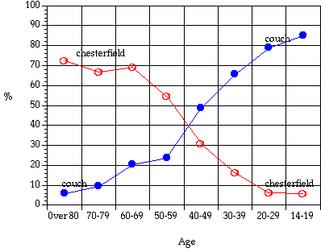
Chambers (1995) couch is replacing chesterfield

Slide 19
Apparent Time Studies
For sociolinguists its is very interesting to see how people accommodate (=attune or adapt their linguistic behaviour in light of their interlocutors' behaviour and their attitudes towards their interlocutors, this maybe conscious or unconscious), new variants into their vernacular.

Slide 20
Apparent Time Studies
In Britain there is a competition between:
Supra-local, non standard variants (like the glottal and th-fronting),
Local vernacular variants
The supra-local prestige forms of Standard English.

Slide 21
There are methods for understanding how these tensions/combetitions get worked out within a particular variety.
A. To examine closely the speech of a small group of speakers and interpret intraspeaker, as well as interspeaker, variation in light of the individuals’ life histories and their current goals and activities.

Slide 22
Tagliamonte 1998 the use of Yorkshire English “was” in existential sentences.
The data
“The result of our fieldwork is a corpus of 132 hours of audiotaped conversations, ranging in length from 1 to 3 hours. The interviews are similar to those obtained in many other sociolinguistic projects of this kind. Each one contains some or all of the elements of informal discourse—personal reminiscences, narratives of personal experience, group interactions, folk stories, and many vibrant characterizations of York today and in the past.”
(Tagliamonte 1998:159)

Slide 23
(1) Affirmative
a. She were a good worker. She was a helluva good worker. (092/568)2
b. There was a lot of us that were sort of seventeen. (004/180,27)
(2) First person singular: /
a. I got the job when I was younger. (009/8)
b. I were broke on a Monday. (003/306)
Second person singular: You
c. You were mentioning windscreen wipers . . . (040/518)
d. You was only away a bit. (008/645)
Third person singular: Pronoun
e. That was the rock and roll era. (005/36)
f. That were a game we invented. (087/163)
Third person singular: Full NP
g. But the war was over then. (017/133)
h. My Dad were up there. (087/468)
Third person singular: Existential there
i. There was only one bus load. (001/419)
j . They said there were nothing wrong. (003/521)
Third person singular: It
k. It was cold on a morning. (044/221)
1. It weren't very satisfactory. (005/100)
From Tagliamonte (1998:155).

Slide 24
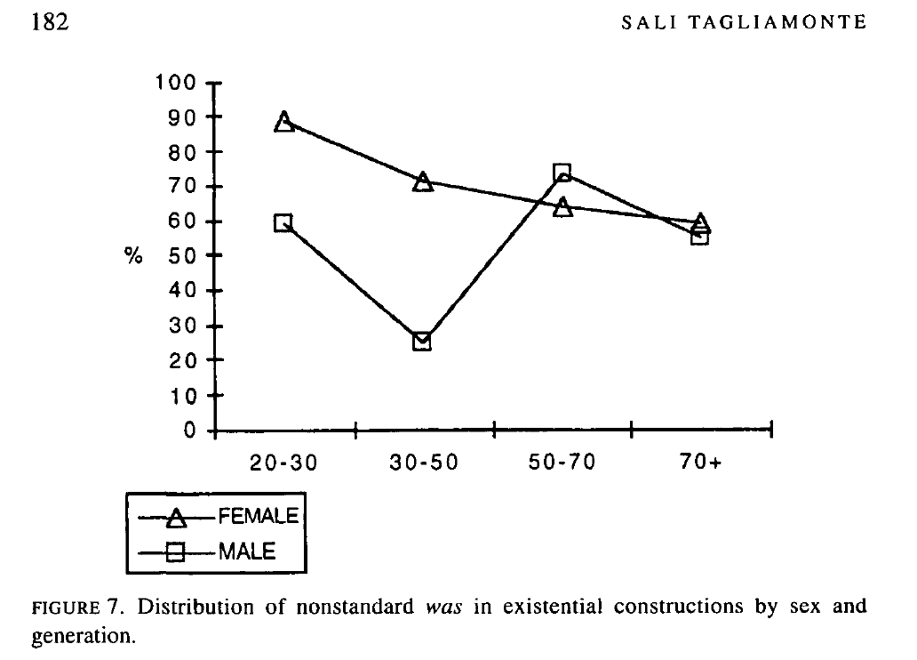

Slide 25
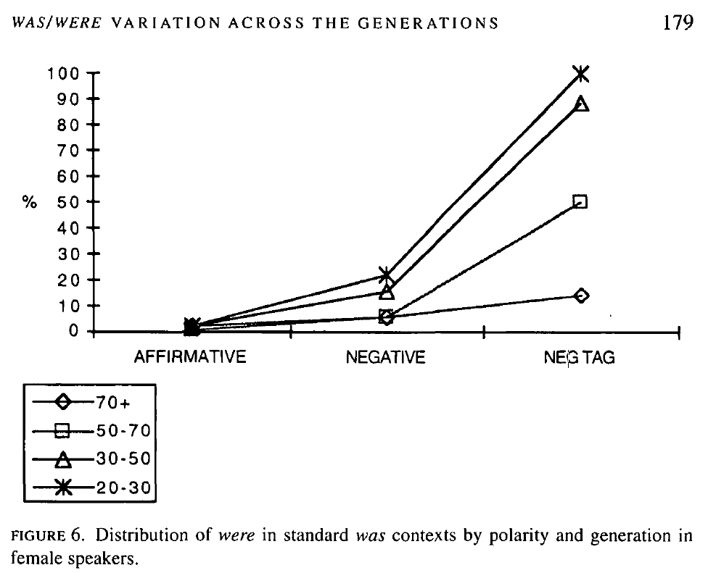

Slide 26
Richard Cameron (1998) used apparent time data to explore variable use of verbs of quotation in Puerto Rican Spanish. These verbs introduce reported speech (so she says.., and she’s like… etc.)
verbs of direct report,
a bare noun phrase (Y yo, "¡¿Ay qué hago?!" 'And I, "Oh, what should I do?'),
freestanding quotation with no frame.

Slide 27
Social constraints reveal complicated, yet familiar influences of age, sex, and class, with teenagers showing parallels to Eckert's work on gender and variation.
Evidence also emerges for both age grading and a change in progress.

Slide 28
The previous studies we examined study the presence or the absence of let say (r). Cameron’s study examines the frequency or the likelihood with which we will find one or other variant in a particular style.
Because Cameron studies 3 variants so a probability below 0.33 indicates that the variant is not favoured among speakersl

Slide 29
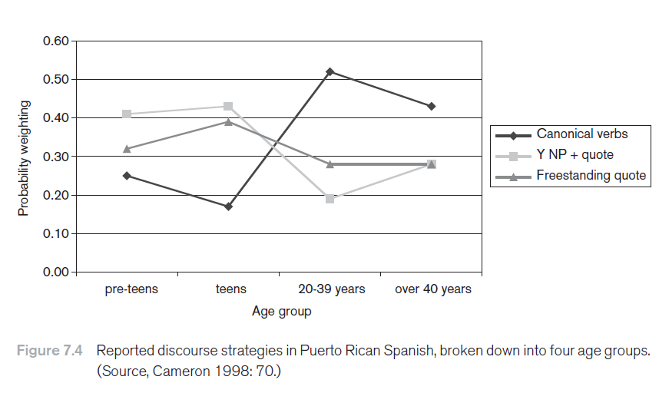
From Meyerhoff 2006:145

Slide 30
Testing Apparent Time Results
Labov’s study of Martha’s Vineyard
He combined apparent time data with the patterns that had been noted in earlier dialect atlas surveys.
Since the earlier dialect surveys had not considered the relative frequency of different forms in individuals’ speech, there were limits on the extent to which his apparent time data could be compared with the dialect survey’s real time information.
> Labov was able to use the apparent time information to infer that the general trends were for younger Vineyarders to centralise the onsets of (ay) and (aw) more, especially if they did not have negative feelings about the island.

Slide 31
Panel studies
Panel studies: Studies of variation across real time when participants are the same.

Slide 32
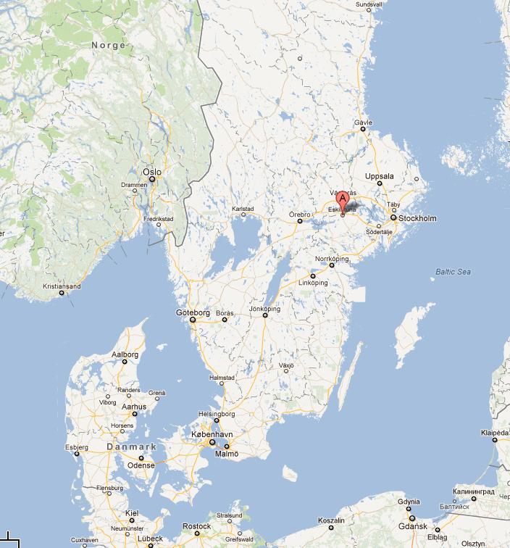
We also have similar panel study data from a Swedish town, Eskilstuna, that retested speakers after thirty years (1967 and 1996), and a recent study looking at a whole suite of variables in Finnish comparing data gathered in 1986 and 1996.

Slide 33
“One of the clearest findings emerging from panel studies is that not all linguistic variables behave the same across a speaker’s lifespan. As a general rule, a speaker’s phonology is more stable than their vocabulary. You will certainly have acquired or learnt new words for concepts and things after the critical period, and we keep acquiring vocabulary throughout our entire lives. In between phonology and lexicon, though, variables behave a bit differently. Some syntactic and morphological variables seem to be treated by speakers as if they were essentially lexical, and so we see the ability for individuals to restructure their systems radically over real time. Some morphological variables seem relatively stable though, and this suggests that speakers understand them as being more like phonological variables.” (Meyerhoff, 2011:140)

Slide 34
Generational change
Each generation in a community shows progressively more and more frequent use of a variant. A change that can be inferred to be taking place on the basis of apparent time evidence is a generational change.

Slide 35
Lifespan change
A term introduced to the study of language variation and change by Gillian Sankoff. A change to a speaker’s pronunciation or grammar that take place after the critical period can be described as a lifespan change. Lifespan changes in pronunciation appear to be severely restricted in their form: they generally only move in the direction of the community overall (see also generational change) and they may also be constrained to certain input or starting points for a speaker. On the other hand, lifespan change is well-attested for vocabulary.

Slide 36
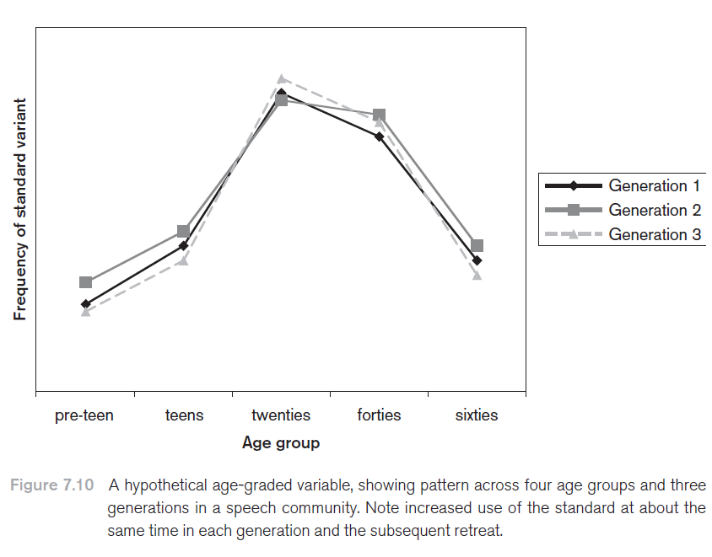
From Meyerhoff 2011:154

Slide 37
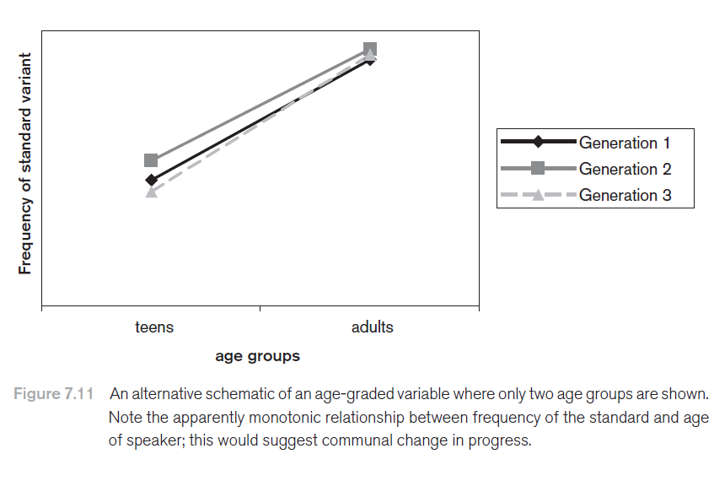
From Meyerhoff 2011:155

Slide 38
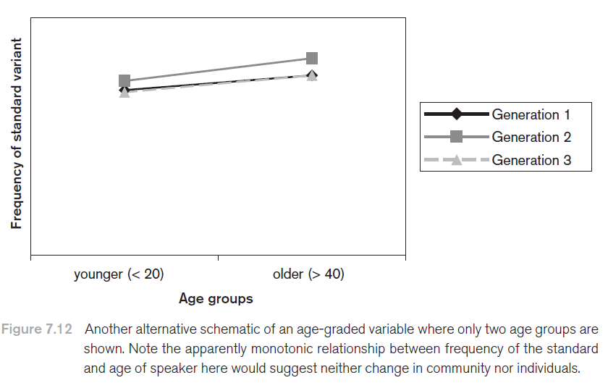
From Meyerhoff 2011:155

Slide 39
Age-grading
If, as a rule, all speakers of a community use more tokens of one variant at a certain age and more tokens of another variant at another age, the variable is said to be age-graded.

Slide 40
Stable variable
If there is no evidence (e.g., from generational change) that one variant is pushing out another variant, the variable can be considered stable.
A classic example is the alternation between the alveolar and velar nasals in the wordfinal -ing which has existed for centuries and shows no signs of disappearing at present. Stable variables may exhibit age-grading (i.e., avoidance of a stigmatised variant in adulthood).

Slide 41
Linguistic marketplace
A way of talking about the extent to which an occupation or activity is associated with use of the standard language.

Slide 42
Thank you

